Slide 1
Established By Government of Jharkhand
and Run by Gurunanak Polytechnic Foundation Under PPP
At-Ghoranegi, P.O- Ghoranegi
District- Saraikela-Kharswan
Jharkhand-832401
Helpline: - 7070282812, 9470146439

Slide 3
ABOUT :
The Department of ELECTRICAL & ELECTRONICS ENGINEERING was established in the year 2017 at the very inception of Chandil Colytechnic, Chandil. The department started with a 3 years Diploma in ELECTRICAL & ELECTRONICS ENGINEERING (capacity of 60 students). The department offers courses to ensure a regular supply of top notch Electrical & Electronics Engineers who have hands on experience and are well versed with latest Electrical & Electronics Technology to fill up the demand gap between industry and academic. Electrical & Electronics engineering students get exposure to practically all fields of engineering.

Slide 4
Vision
To be a place of academic excellence by imparting quality teaching, carrying out research and technology development in frontier areas of Electrical & Electronics Engineering.
Mission
To produce Electrical & Electronics Engineers having strong theoretical foundation, good design experience and exposure to research and development.
To produce post-graduate Electrical & Electronics Engineers who have strong theoretical foundation and research and development experiences in their chosen discipline.
To produce researchers who have clear thinking, articulation and interest to carryout theoretical and /or applied research resulting in significant advancement of the field of specialization.
To be a place for innovation and technology development in frontier areas of Electrical & Electronics Engineering.

Slide 5
The Department Offers The Following Degrees For Higher Studies :
B. Tech in Electronics & Communication Engineering.
B. Tech in Electrical & Electronics Engineering.
M. Tech in specializations : i) Signal Processing.
ii) VLSI.
iii) Communication Engineering.
iv) Power and Control.
v) Power Electronics.
vi) Power System.
PhD degree in all the major areas of faculty expertise as mentioned above.

Slide 6
Top Ten EEE Achievements in the 20th Century.
Electric Powered Personal Flying Machine.
Computer-aided Engineering Technology.
Satellite & Navigation System.
Energy Storage Device from Nature.
Electrical Power Converter that Allows Grid to Easily Accept Power from Renewable Energy.
Developing Technology for Autism and Behavioral Therapy.
Research & Development Sector.
Automobile.
Household Appliances( AC, Refrigerator, Cooler etc ).
Aircraft & Defence Organisation.

Slide 7
Why we choose Electrical and Electronic Engineering
in Polytechnic ?
EEE is an Electrical Engineering & Electronics Engineering discipline which utilizes
nonlinear and active electrical components (such as semiconductor devices,
especially transistors, diodes and integrated circuits) to design electronic
circuits, devices, VLSI devices and their systems.
Electrical and Electronics Engineers have good Graduate Prospects.
Global opportunities.
Electrical and Electronics Engineers are always in demand.
Electrical and Electronics Engineers are at the forefront of future technologies.
High CTC.

Slide 8
What will you get in CPC ?
Professionals working in: industry, academic,government and so on...
NPTEL.
Hands on experience.
Advance workshop.
Personality development classes.
Goal oriented teaching.

Slide 9
COURSE STRUCTURE
1st and 2nd SEMESTER – COMMON FOR ALL
3RD SEMESTER SYLLABUS
Engineering Math – III
Electrical Engineering
Measurement
Electronics Engineering
Basic Engineering(C&M)
4th SEMESTER SYLLABUS
Network Theory
Electrical Machine I
Microprocessor
Electrical Estimation & Costing
Power System

Slide 10
COURSE STRUCTURE
5th SEMESTER SYLLABUS
Instrumentation System
Electrical Machines II
Electronics Sys. Design & Maintenance
Illumination Engineering
Control System
6th SEMESTER SYLLABUS
Industrial Engineering & Management
Utilization of Electrical Energy
Power Electronics
Renewable Energy Sources
Communication System/DSP

Slide 11
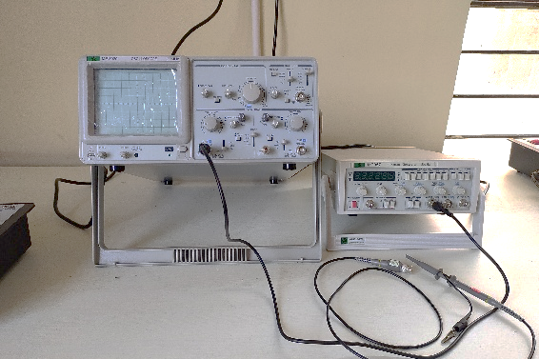
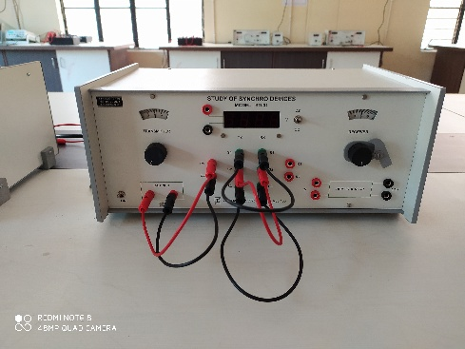
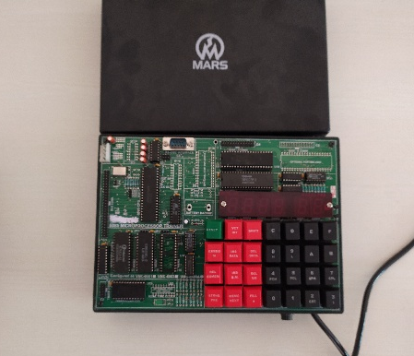
EEE DEPARTMENTAL LABORATORY
ELECTRONICS ENGINEERING LAB.
INSTRUMENTATION SYSTEM LAB.
DIGITAL CIRCUIT AND MICROPROCESSOR LAB.
POWER ELECTRONICS LAB.

Slide 12
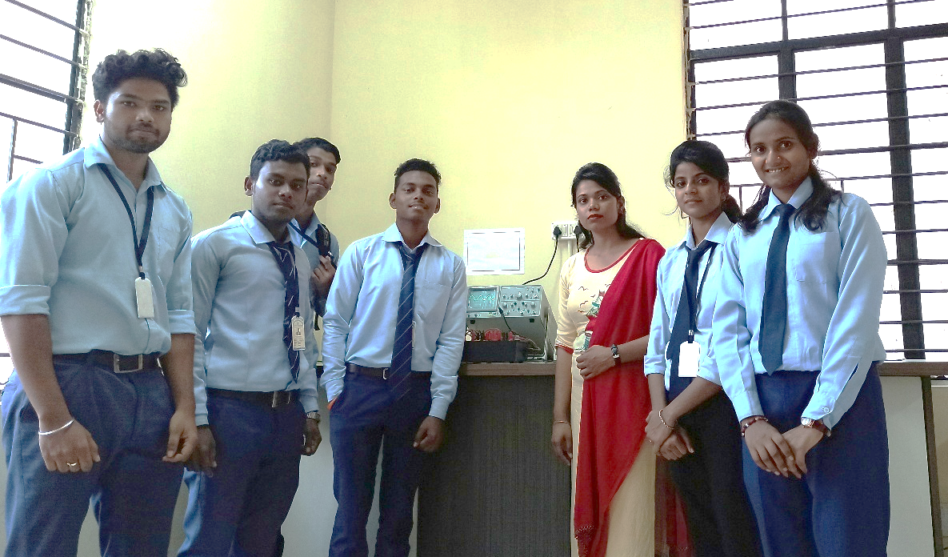
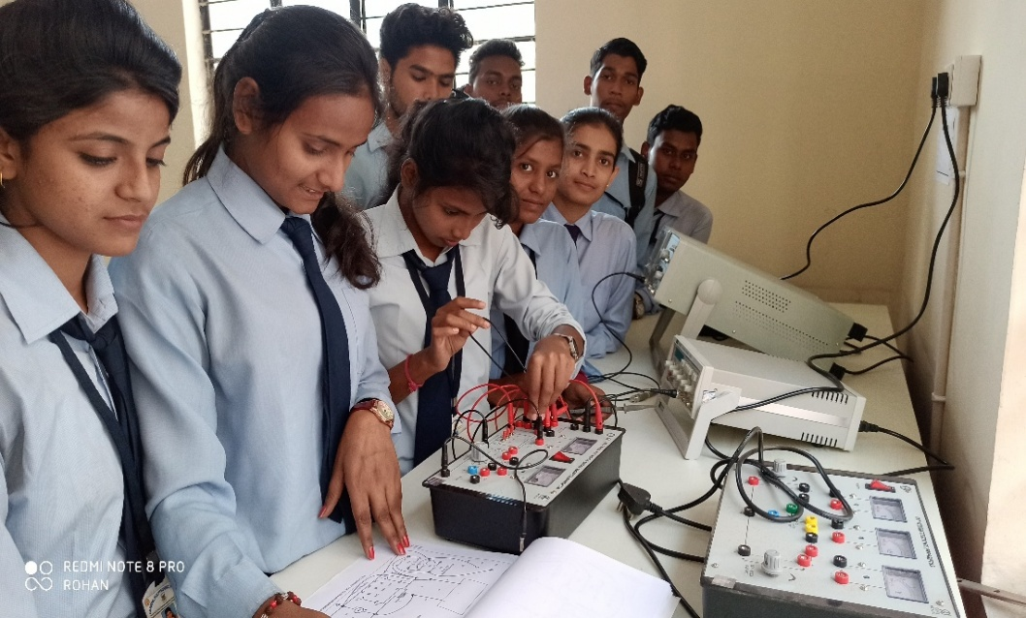
ELECTRONICS ENGINEERING LAB

Slide 13
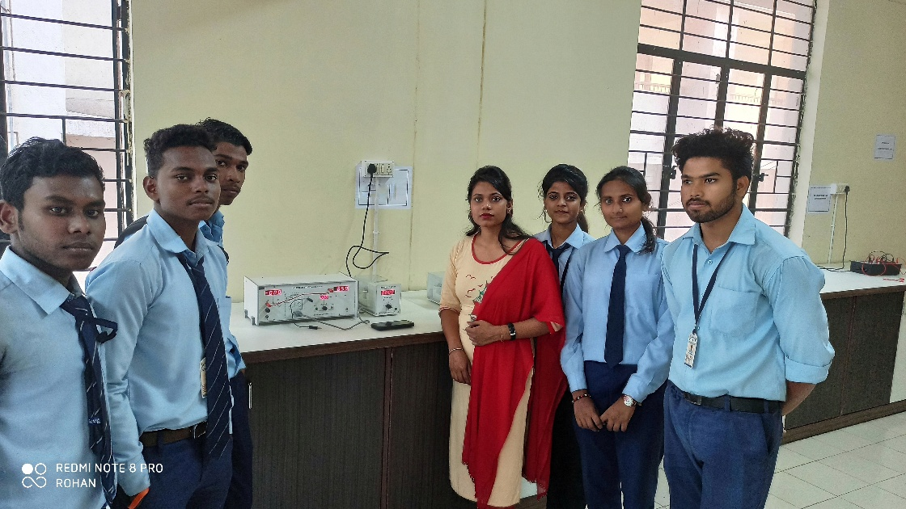
INSTRUMENTATION SYSTEM LAB

Slide 14
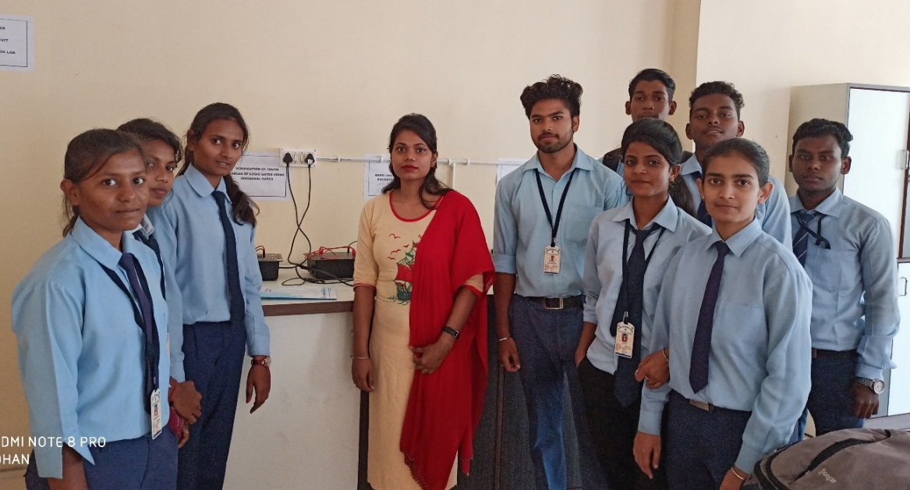
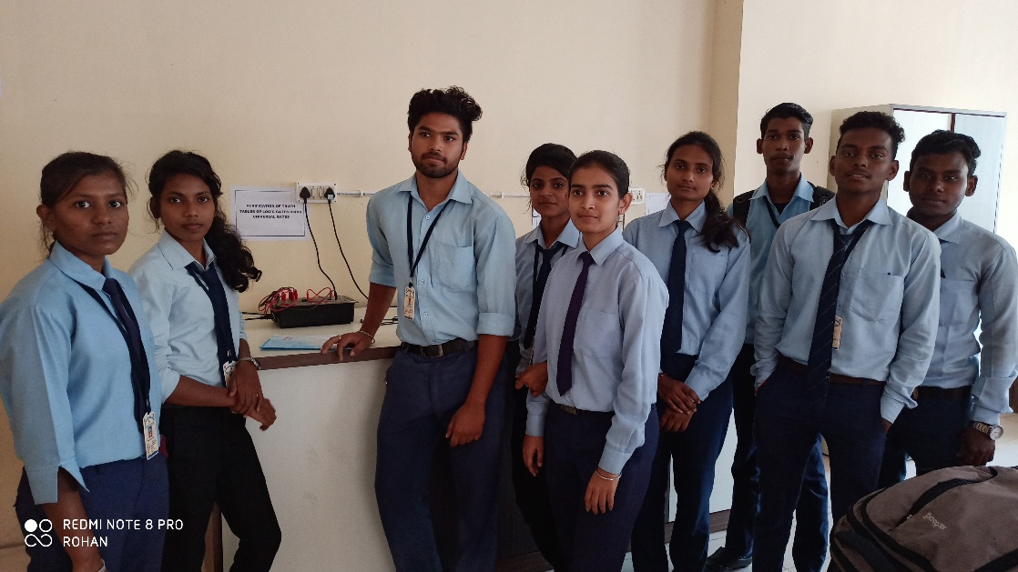
DIGITAL CIRCUIT
&
MICROPROCESSOR LAB

Slide 15
JOB OPPORTUNITIES
SIEMENS LIMITED.
BOSCH LTD.
SCHNEIDER ELECTRIC.
BHEL.
ELECTROSTEEL STEELS LIMITED.
SOFTWARE COMPANY.
AUTOMOTIVE MANUFACTURERS.
ORIGINAL EQUIPMENT MANUFACTURERS (OEM).
NOTE : Electrical & Electronics Engineering is a branch where all sorts of engineering and technologies are involves e.g. Electrical, Electronics,
IT Industry, Software & Hardware Industries.

Slide 16
THANK-YOU

